Slide 1
CAPSTONE PROJECT
Batch details | PGPDSE-FT GURGAON AUG22
Team members | Rishu Gupta Muskan Jain Braj Bhooshan Uraon Ritika Joshi Khushboo Verma
Domain of Project | Sales Analytics
Proposed Project Title | Price prediction of used cars
Mentor Name | Mr Jayveer Nanda

Slide 2
BUSINESS PROBLEM STATEMENT
The main objective of our work is to build a Machine Learning model, which predicts the optimal price of a preowned car or used car on the basis its features for the business .In an unorganized ecosystem the price of a pre-owned vehicle boils down to awareness, negotiation skills, availability of vehicle, price sensitivity thus, we are trying to solve for the inefficiencies in the used car ecosystem by leveraging data analytics.

Slide 3
Variable information/Data description -Target Variable Price
id | entry ID
url | listing URL
region | craigslist region
region_url | region URL
price | entry price
year | entry year
manufacturer | manufacturer of vehicle
model | model of vehicle
condition | condition of vehicle
cylinders | number of cylinders
fuel | fuel type
Odometer | miles travelled by vehicle
title_status | title status of vehicle
transmission | transmission of vehicle
VIN | vehicle identification number
drive | type of drive
size | size of vehicle
type | generic type of vehicle
paint_color | color of vehicle
image_url | image URL
description | listed description of vehicle
county | useless column left in by mistake
state | state of listing
lat | latitude of listing
long | longitude of listing
posting_date | posting date

Slide 4
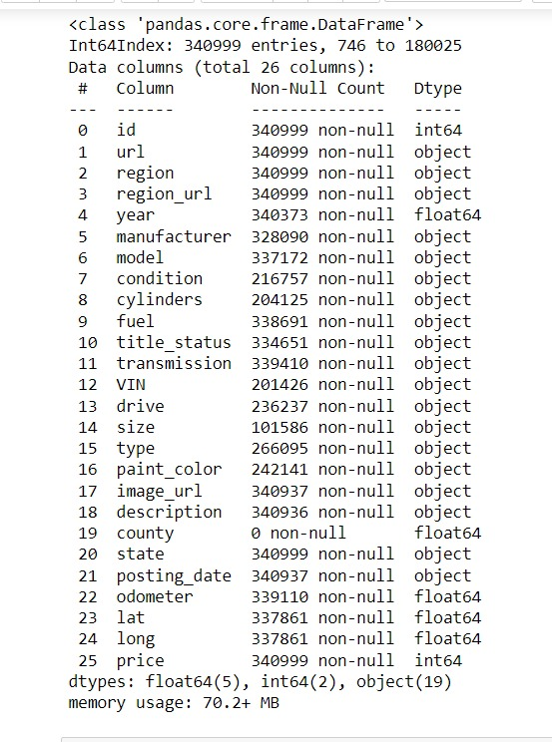
DATA PREPARATION INFORMATION OF THE DATA:
In our data we have 340999rows and 26 columns
Year and County are in float type. We have changed them to object .
In our data , we have 24 duplicated rows which we have treated by dropping them
In our data , we have attribute, URL , region_url , image_url , id , description which is not adding anything to the data.
we also have attributes region , lat and log which indicates to the same information

Slide 5
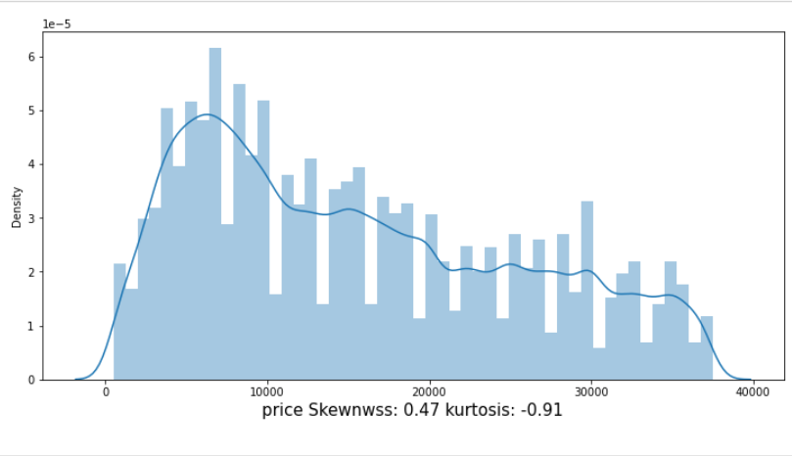
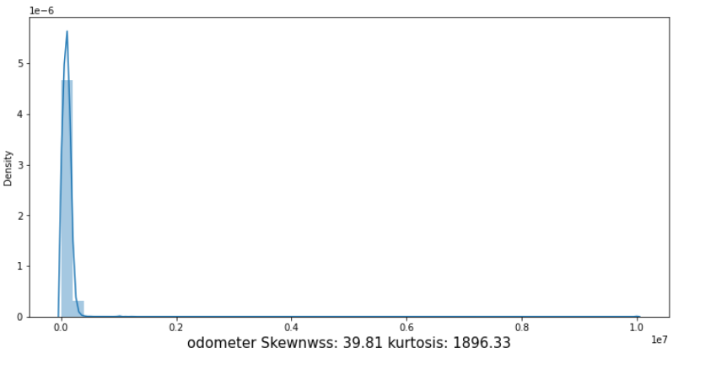
UNIVARIATE ANALYSIS NUMERICAL VARIABLEs - Price, Odometer
Price is kind of uniformly distributed having skewness 0.47 and kurtosis -0.91
Odometer is highly skewed with skewness of 39.81 and kurtosis 1896.33

Slide 6
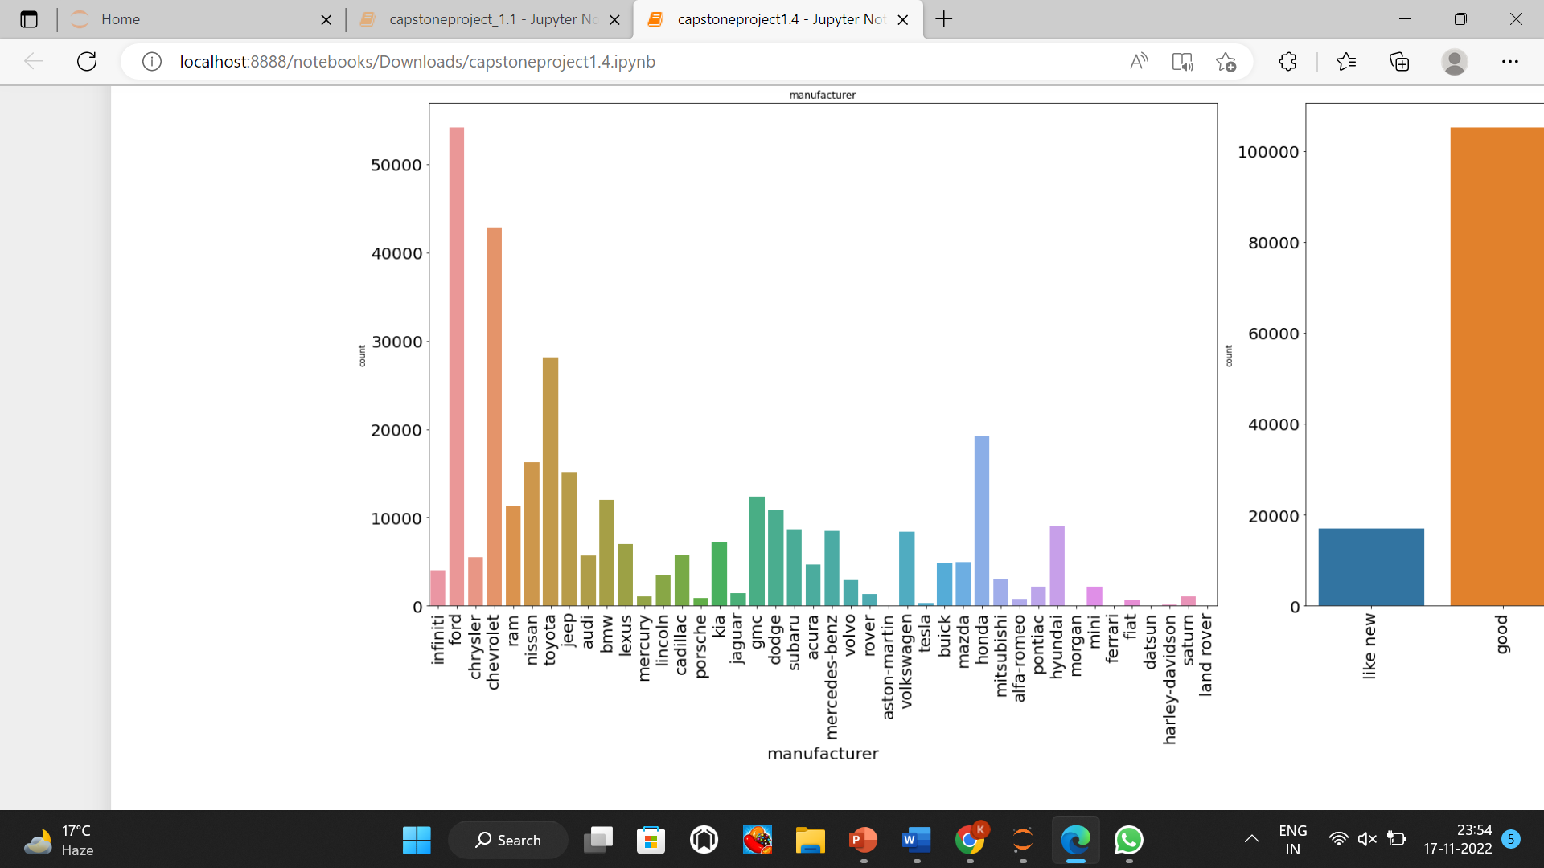
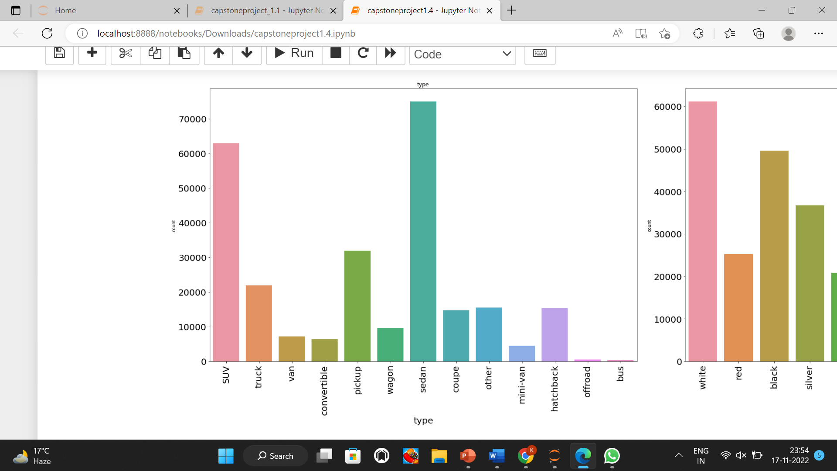
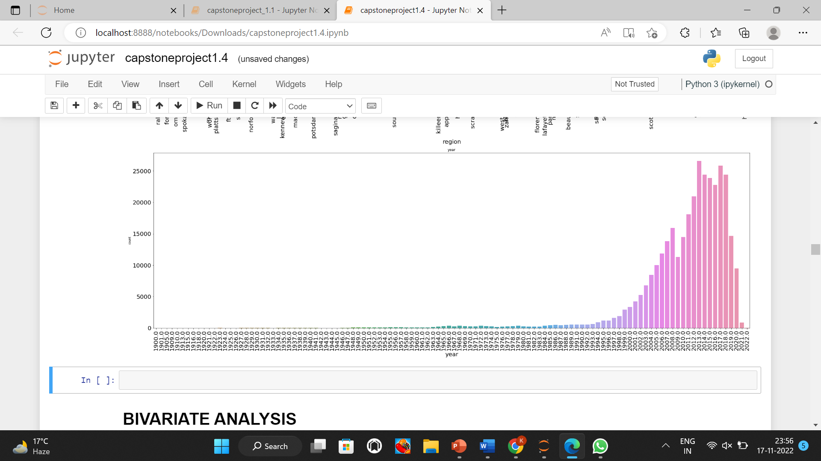
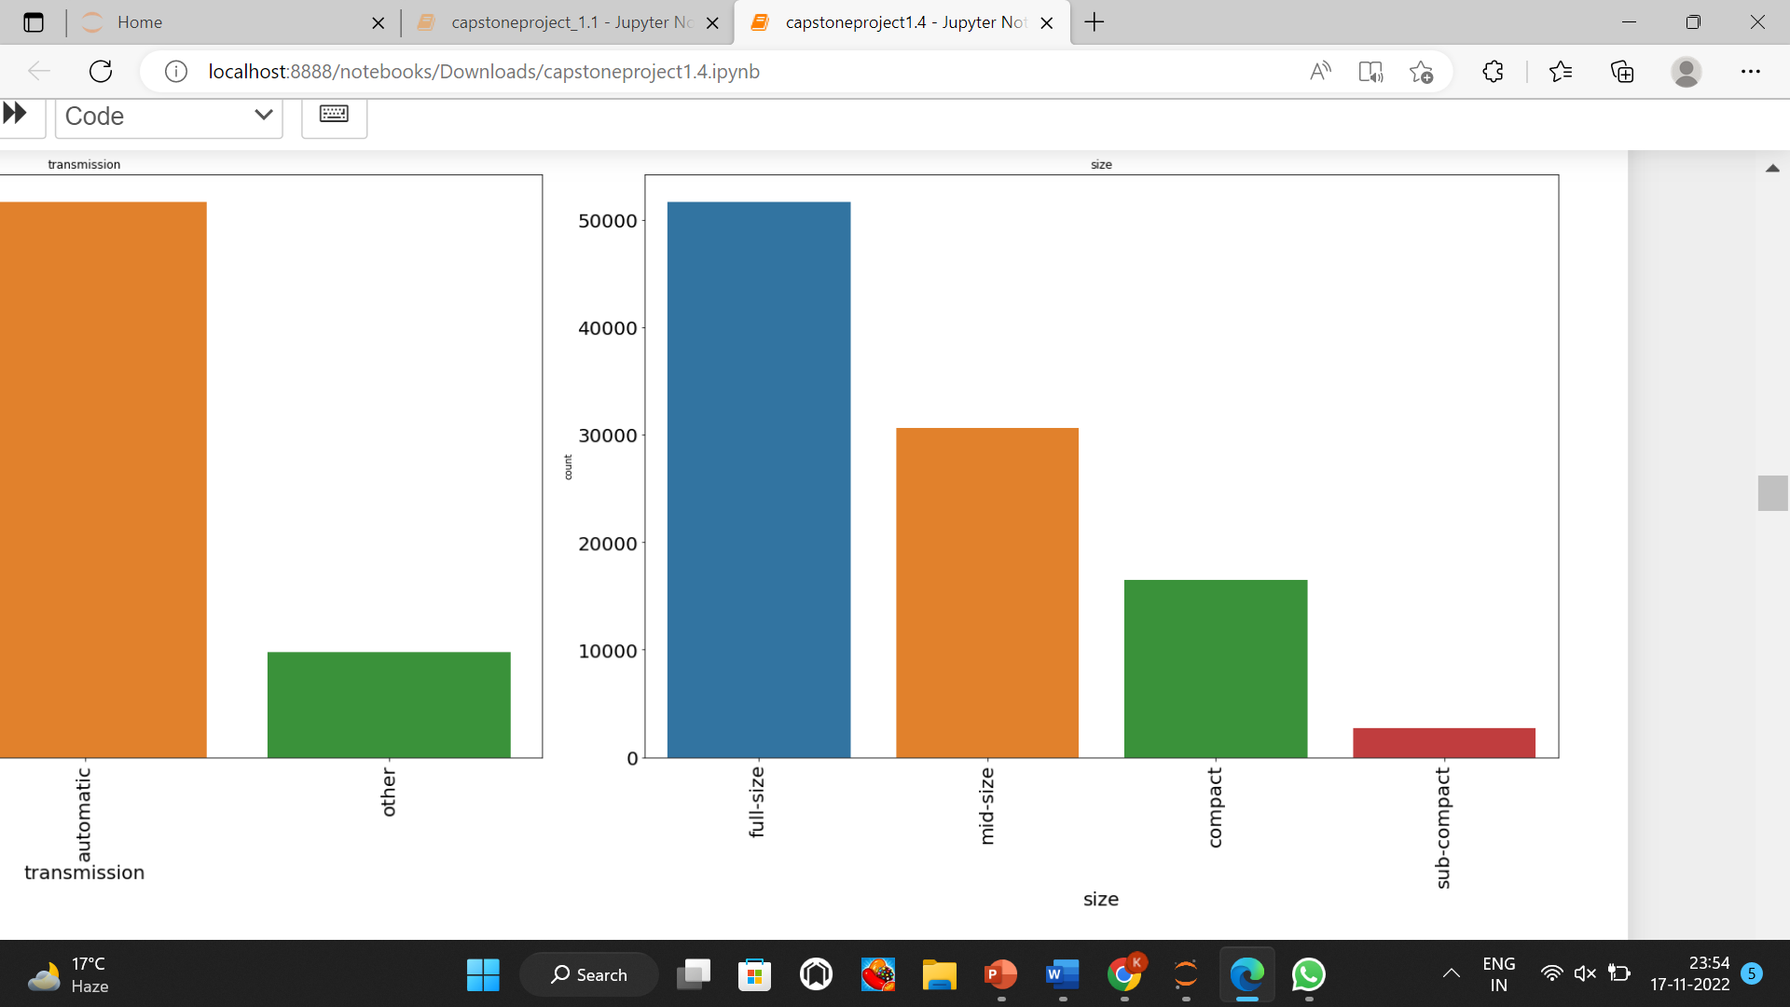
UNIVARIATE ANALYSIS CATEGORICAL VARIABLES
We can see that there are number of manufactures
The sale of car from FORD is the highest followed by Chevrolet and Toyota
And miniumun sale is from aston-martin,morgan and Ferrari
The number of Full size cars are more
followed by mid-size
Manufactures
Types
The Number of sedan type cars is most, followed by SUV and pickup. Where the least is bus and off road.
The use of pre-owned cars is in increasing trend. Most number of cars are sold from 2013 manufactured.
Years
Size

Slide 7
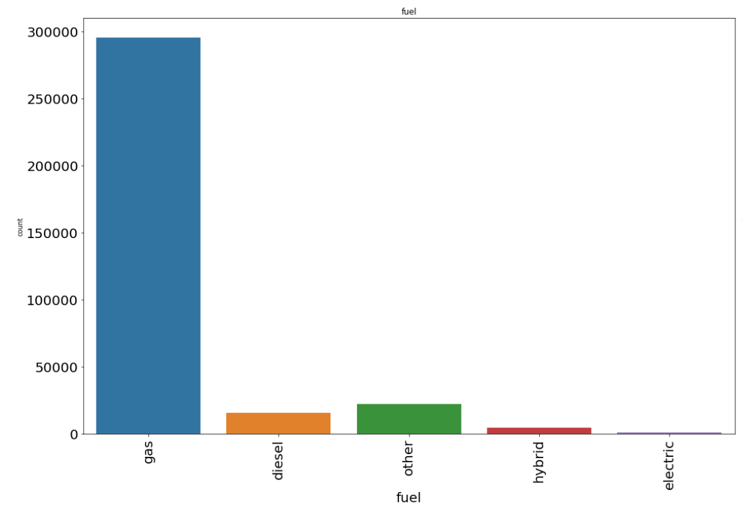
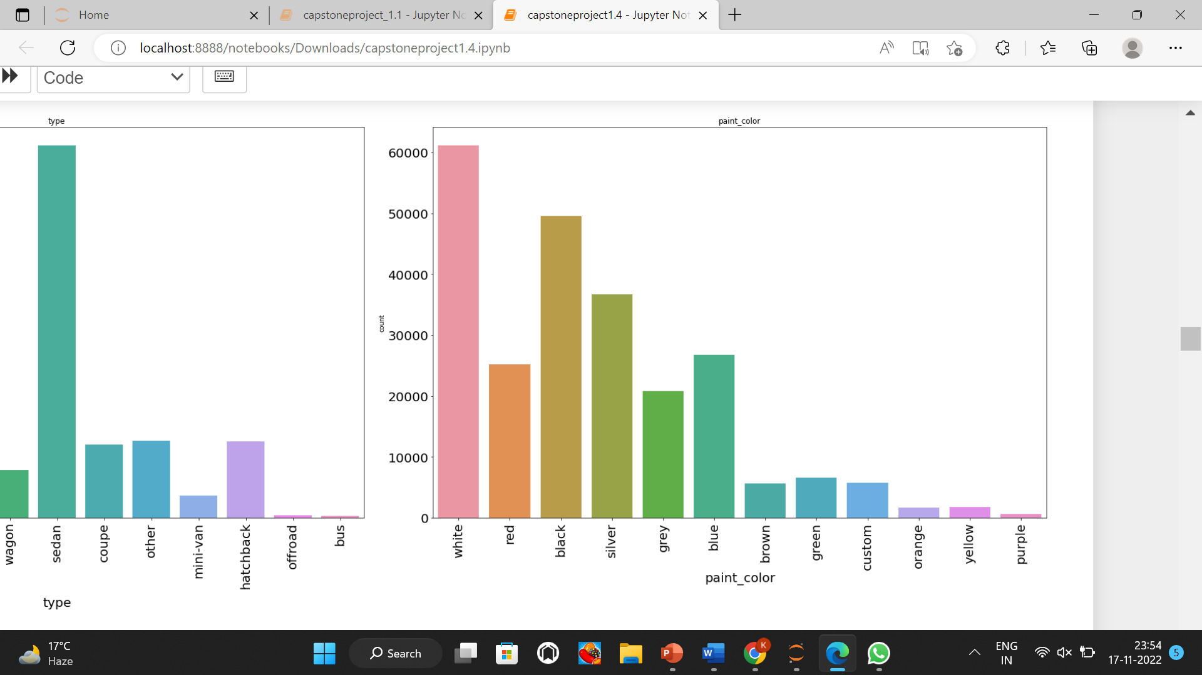
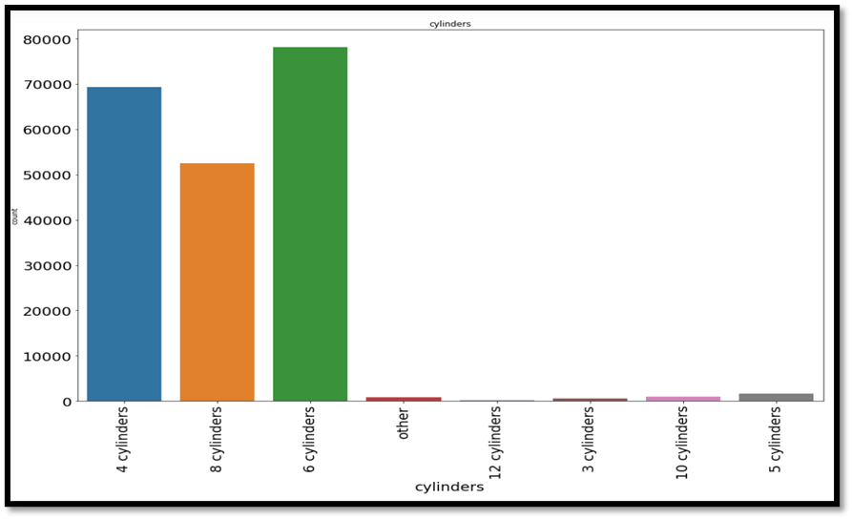
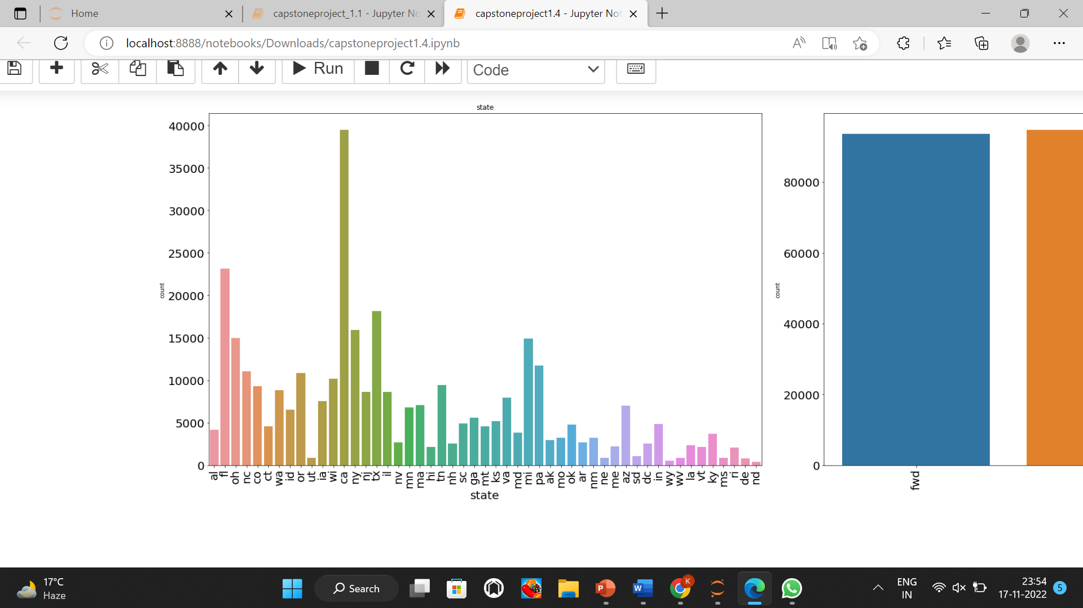
The number of cars which runs on gasoline are maximum.
whereas electric cars count is least.
Most number of cars for resale are listed from California .
While the least number of cars which are listed for resale are from Wyoming.
Fuel
Paint colour
The max number of cars being
sold are of 6,4,8 cylinders
Most care being sold are of white color , followed by black and silver
While the least sold cars are of purple.
cylinders
States

Slide 8
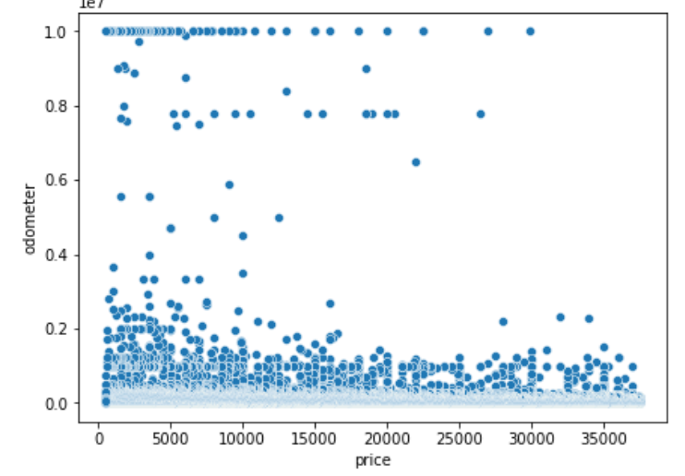
BIVARIATE ANALYSIS NUMARICAL VS NUMARICAL VARIABLES
Odometer vs Price-Majority of the odometer reading are upto 200000 units.
There are extreme values present in the odometer readings.

Slide 9
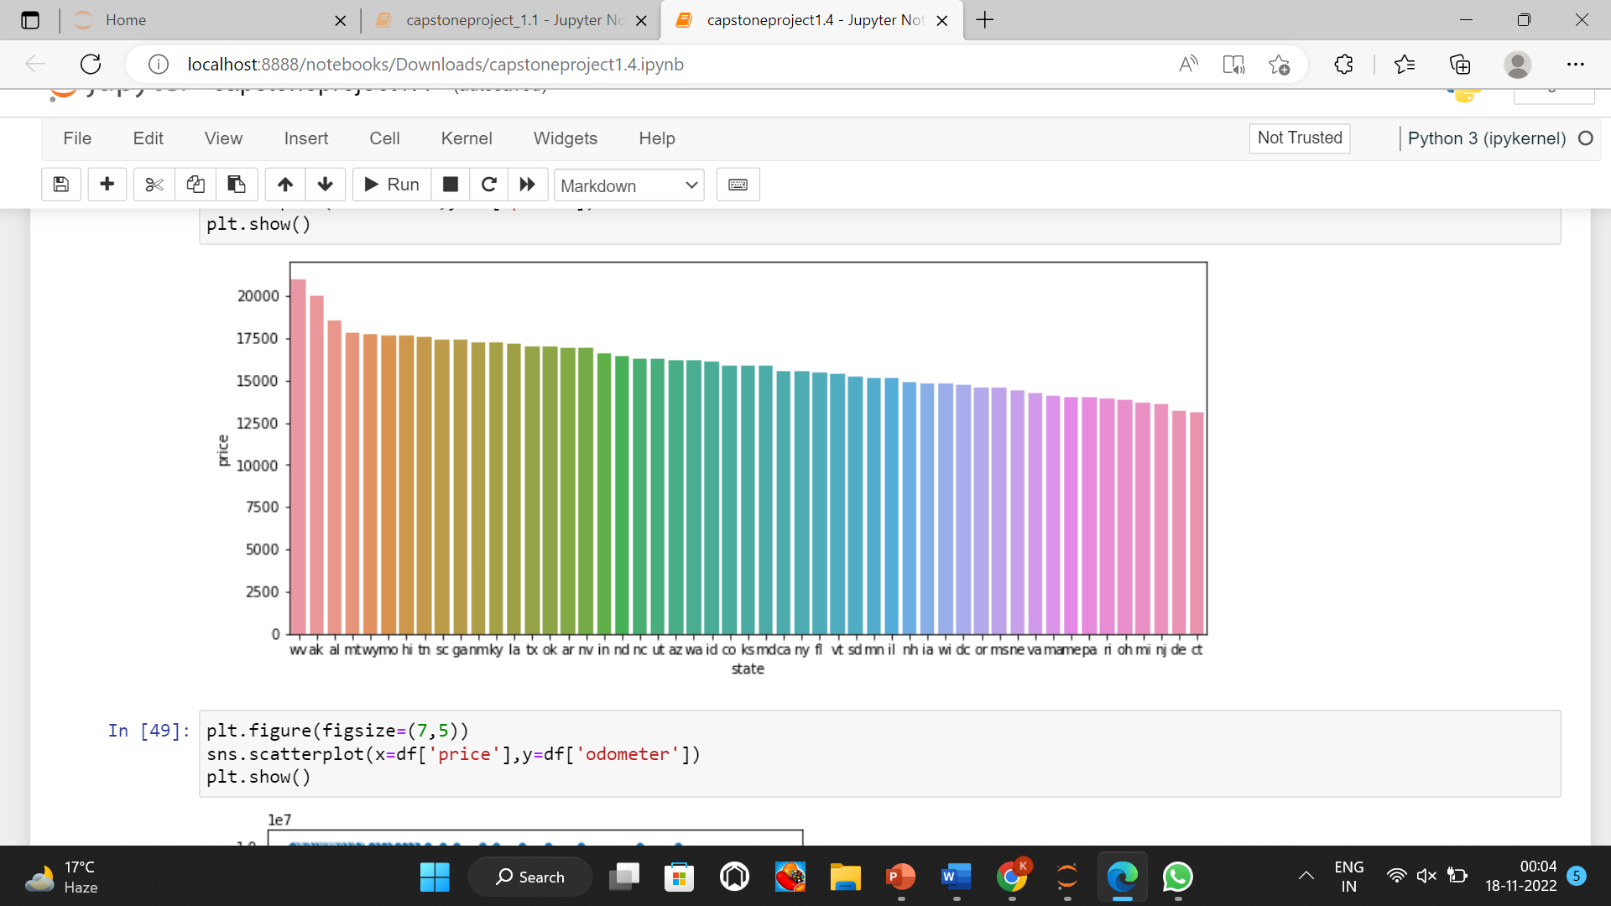
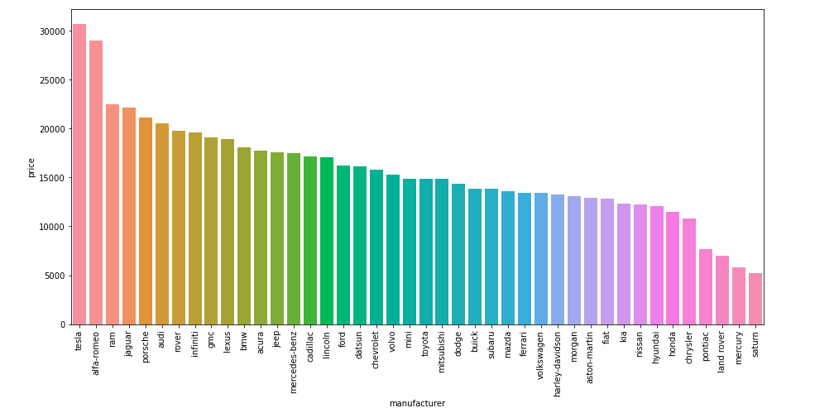
BIVARIATE ANALYSIS NUMARICAL VS CATEGORICAL VARIABLES
Price vs state-The Average Price of cars being sold is highest in West Virginia followed Alaska and Alabama
Other States have almost similar Average Price
Price vs manufacturer Tesla cars have highest average price, followed by alfa- Romeo.
While the least average price is of Satum

Slide 10
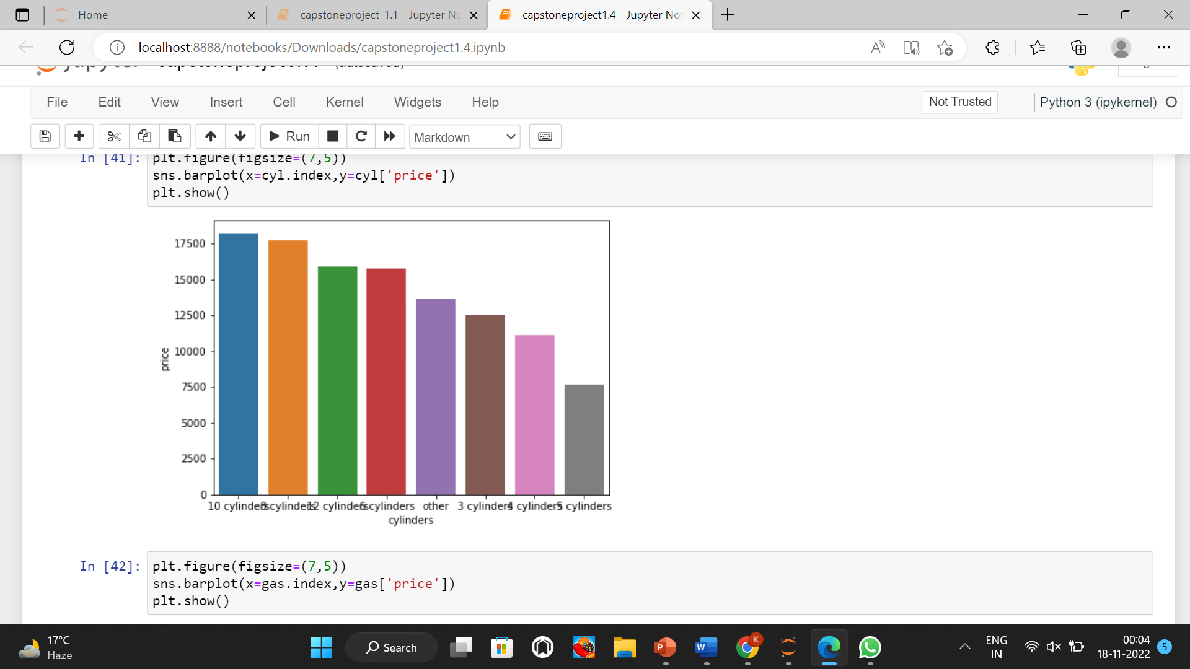
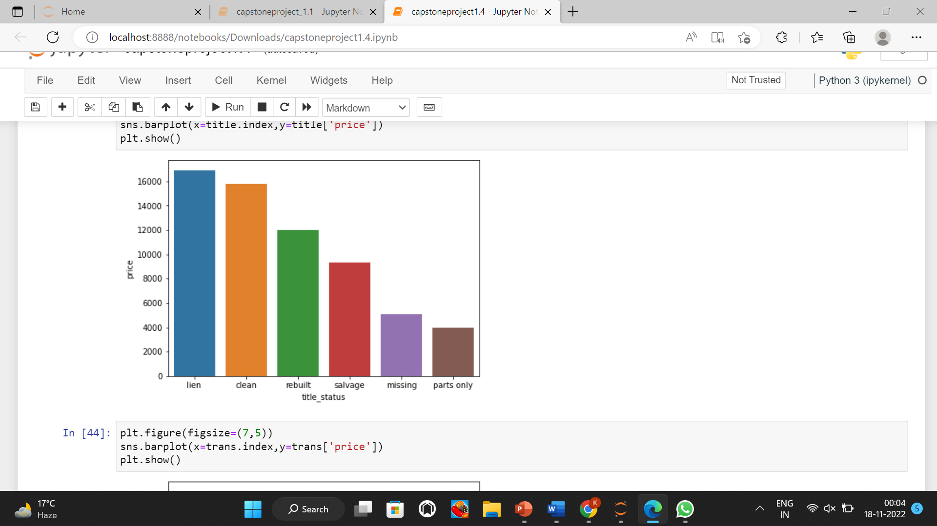
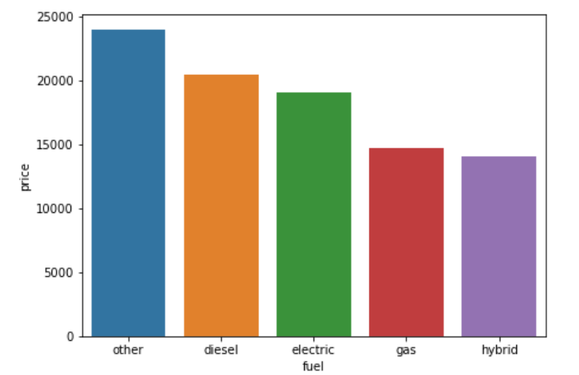
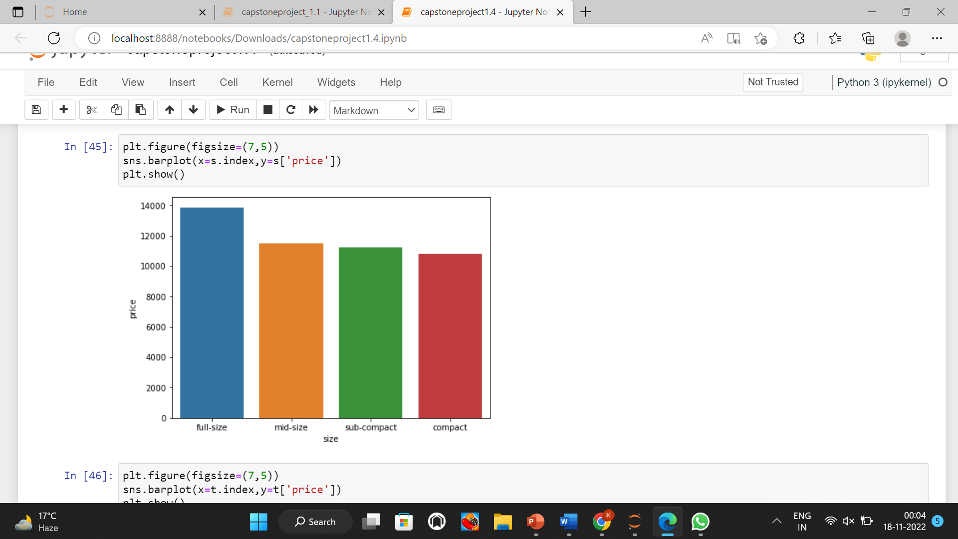
Price vs cylinders-Highest Average price is of cars which have 10 cylinders
while the lowest average price is of cars which have 5 cylinders.
price vs size-The average price of the full size cars is highest while the rest have similar average price

Slide 11
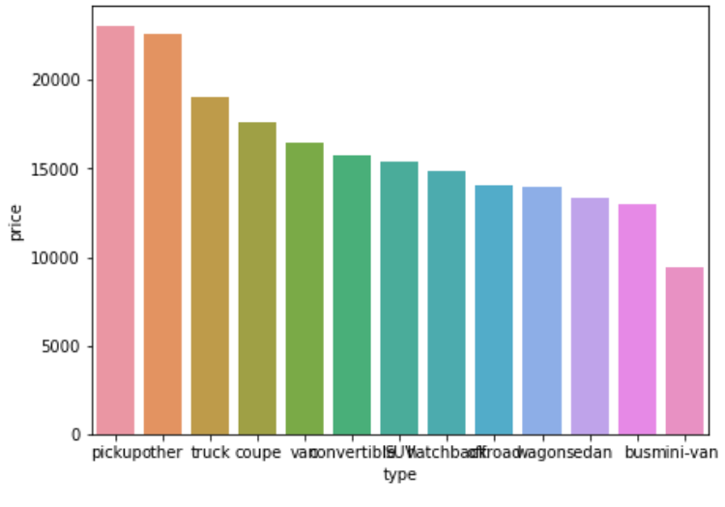
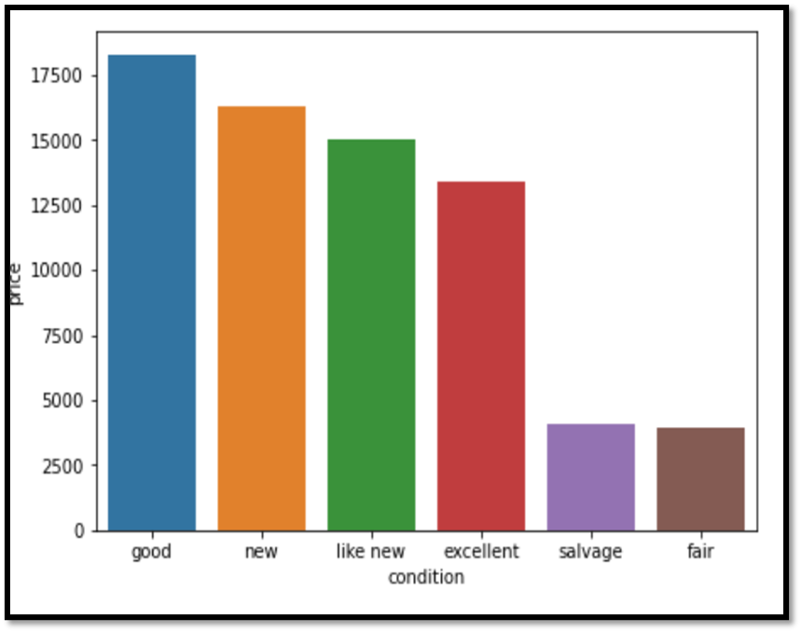
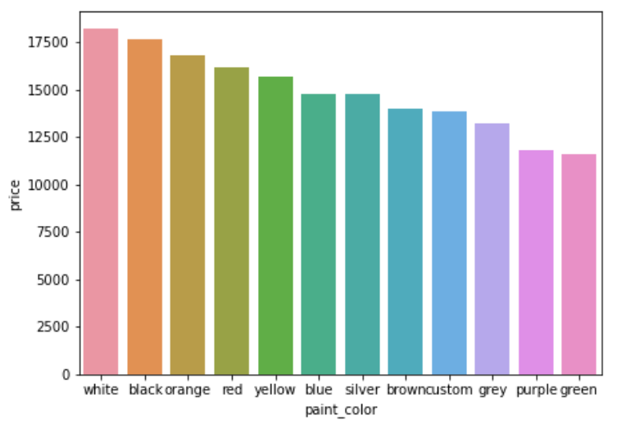
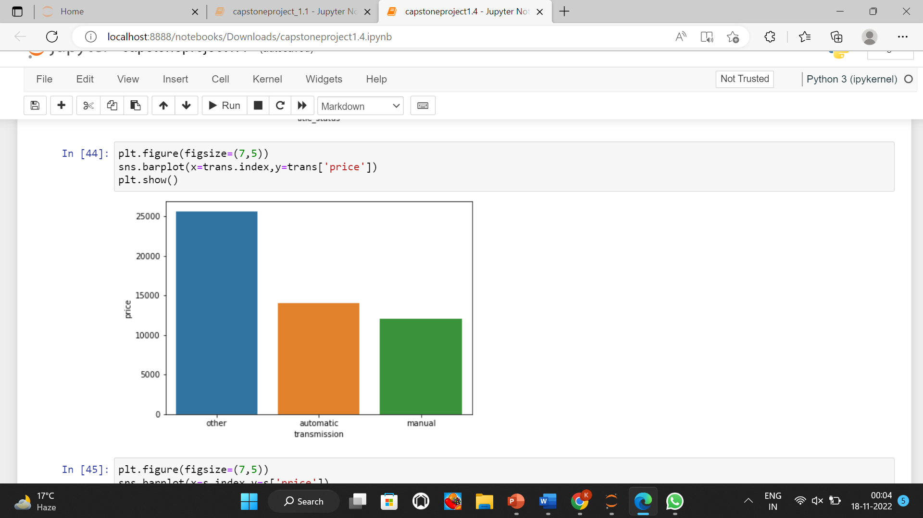
Price vs type-The average price of pickup cars is highest followed by others while the least is of mini-van
Price vs paint_colour-The average highest price is of white color followed by black and orange while the least is of purple and green.

Slide 12
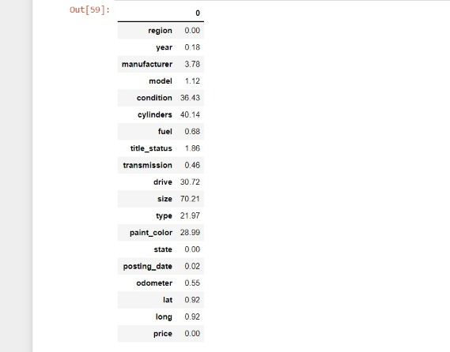
MISSING VALUES
We observe that, there are missing values in 13 columns.
Size , VIN , county have high missing values so we are dropping them.
The null values in categorical columns will be filled with highest frequency value in their respective columns.
The missing values in odometer will be filled by median of that column.

Slide 13
FEATURE ENGINEERING
We have extracted the age of the vehicles from the ‘YEAR’ column.
We have classified the colors into limited categories which are: Custom , Light and Dark
We have extracted the Date of posting from ‘posting_date’ column to simplify the data .
-We have added the date column in the dataframe.
-We have dropped the posting_date column because it is not needed anymore.
We have removed the word ‘Cylinder’ from the Cylinder column to make it easier to encode.
In our data , we have attribute, URL , region_url ,VIN, image_url , id , description which is not adding anything to the data.
We also have attributes region , lat and log which indicates the same information because it leads to the redundancy in the data.
As we have only one numerical feature that is odometer, and we have outliers in it but these outliers are good outliers as there could be chances that a car can have an extreme odometer reading. Although we dropped rows where odometer reading was zero.

Slide 14
TRANSFORMATION & ENCODING
In the data, we have used the different Encoding Techniques:
One Hot Encoder: It is a common method for dealing the categorical data in machine learning, in which categorical features are mapped with binary variables either 0 or 1. , the columns are : ‘fuel’ , ‘transmission’, ‘drive’ and ‘color’.
Ordinal Encoder: It converts each label into the integer value and encoded the data represents the sequence of labels, and the columns are ‘cylinders’ and ‘condition’.
Frequency Encoder: It is a way to utilise the frequencies of the categories as labels, and the columns are ‘manufacturer’, ’model’, ’type’, ’state’ and ‘title_status’.
We have used Yeojohnson transformation technique in the data to transform the ‘Odometer’ numerical column.

Slide 15
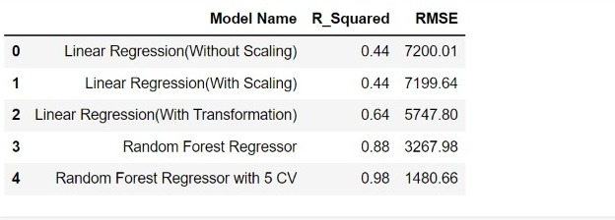
MODEL DEVELOPMENT
Linear Regression : It is used to predict the value of the variable based on value of another variable.
For improving the Model, We will apply the Power Transformation and StandardScaler on the odometer, year and age variables.
After Scaling and Transforming the Data, the results are:
Decision Tree Regressor: It observes features of an object and train a model in a structure of a tree to predict data in the future to produce the meaning continuous output.

Slide 16
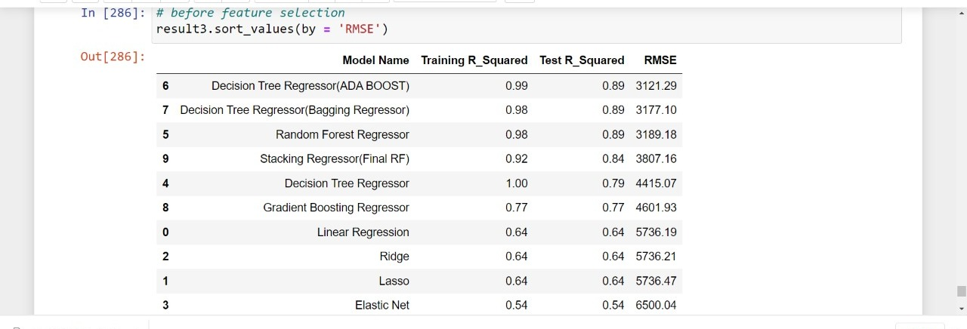
.Random Forest Regressor: It is a technique that combine prediction from multiple machine learning algorithms to make more accurate prediction than a single model.
We have also built models like: Lasso, Ridge, ElasticNet, Bagging regressor and gradient boost regressor.
RESULT:
k-FOLD with Random Forest is giving best results as the RMSE is the lowest as compared to other models.

Slide 17
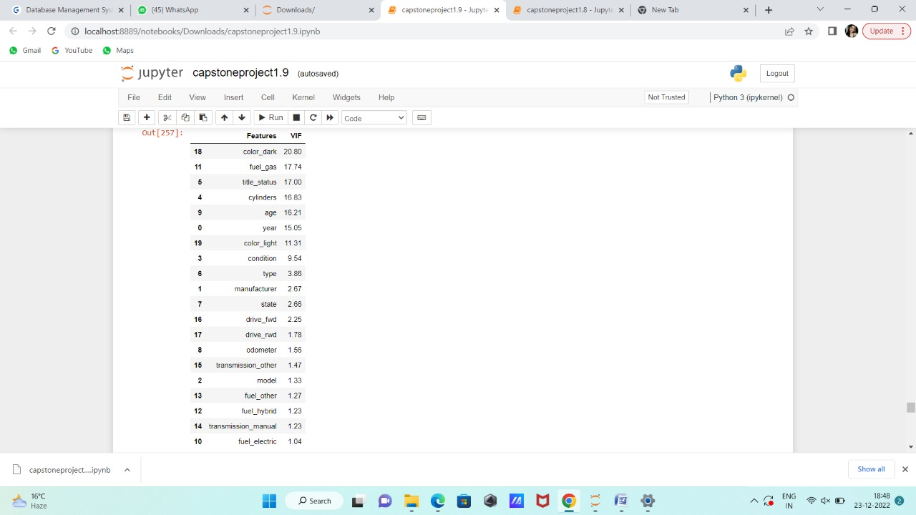
Sequential Feature Selection: features are sequentially added to an empty set of features until the addition of extra features does not reduce the criterion.It helps in selecting important features in the data by calculating SFS:
Selected Features are :
year
model
cylinders
Title_status
odometer
age
fuel Electric
fuel_gas
fuel_hybrid
transmission_manual
transmission_other
drive_fwd

Slide 18
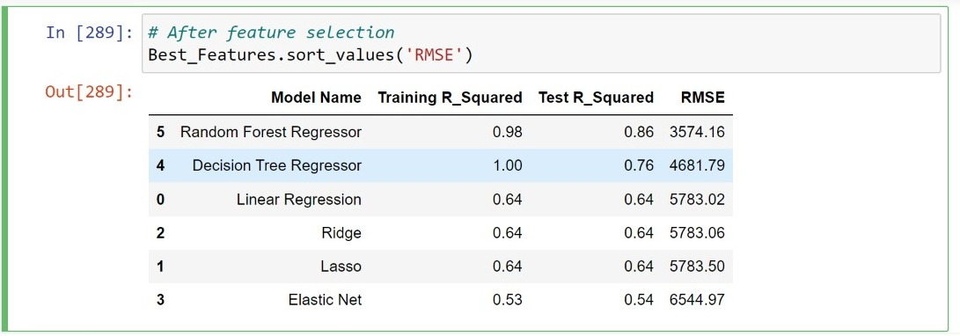
We have built the models that are: Random Forest, Decision Tree, Linear Regression,Ridge ,Lasso,Elastic Net after selecting the feature by SFS: Results : We can infer from this result, Random Forest Regressor is the best fit Model after Feature Selection.

Slide 19
CONCLUSION:
The most challenging part of this project was understanding the dataset and its various features.
We budgeted the majority of my time toward understanding what information each feature contained, how this information was distributed, and what sort of preprocessing techniques would need to be applied.
Dealing with the dataset's overabundance of missing values, or `NaN' entries, proved to be the trickiest part of the data preprocessing phase and since most machine learning algorithms aren't designed to overlook missing entries.
We had to overcome this challenge. We implemented several steps to pick the best features as much as possible.
From the overall model, we conclude that random forest with K-Fold is the best fit model. It has an R2 of 98% and RMSE 1488.69.

Slide 20
THANK YOU

